Slide 1
IS-LM MODEL
Ravi Kiran

Slide 2
IS-LM model
The IS-LM model was developed by the economist John Hicks in 1937 based on J. M. Keynes “General Theory”.
The IS-LM model shows how the level of national income and rate of interest are jointly determined by the simultaneous equilibrium in the two interdependent goods and money markets.

Slide 3
IS-LM model
Goods Market covers the buying and selling of goods and services.
Money Market deals with the interaction between demand for money and the supply of money.
The IS curve shows different equilibrium levels of national income with various rates of interest.
It is the locus of those combinations of rate of interest and the level of national income at which goods market is in equilibrium.
IS curve always slopes downward to the right (negative slope).

Slide 4
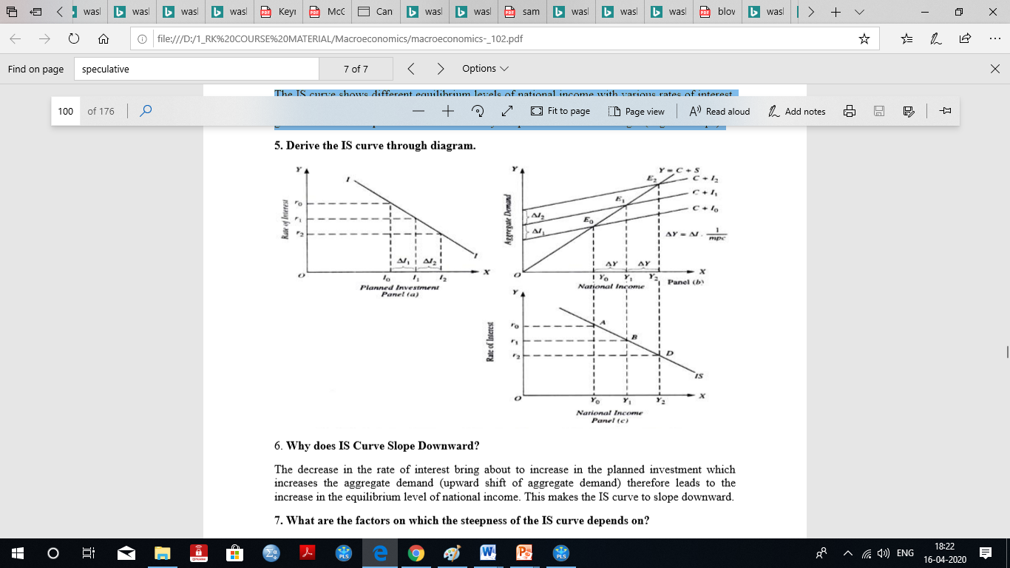
IS Curve
The decrease in the rate of interest bring about an increase in the planned investment which increases the aggregate demand (upward shift of aggregate demand) therefore leads to the increase in the equilibrium level of national income.
This makes the IS curve to slope downward

Slide 5
Marginal Propensity to Consume (MPC)
Marginal propensity to consume (MPC) is defined as the proportion of an aggregate raise in pay that a consumer spends on the consumption of goods and services, as opposed to saving it.
The marginal propensity to consume=ΔC/ΔY, where ΔC is the change in consumption, and ΔY is the change in income.
If consumption increases by 80 cents for each additional dollar of income, then MPC is equal to 0.8 / 1 = 0.8.

Slide 6
IS Curve
There are two factors on which the steepness of the IS curve depends on:-
1. the elasticity of investment demand curve;
2. the size of the multiplier.
Autonomous expenditure which determines the position of the IS curve and changes in the autonomous expenditure causes a shift in it.
[The formula for calculating the investment multiplier of a project is simply = 1/(1−MPC)]

Slide 7
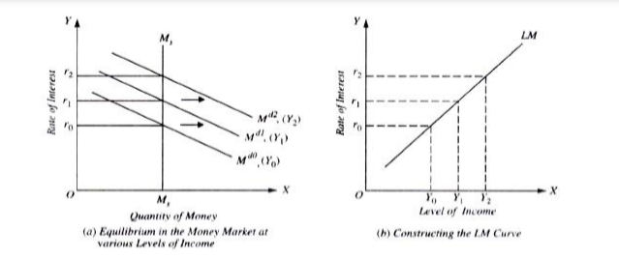
The LM curve relates the level of income with the rate of interest which is determined by money-market equilibrium corresponding to different levels of demand for money.
The LM curve tells what the various rates of interest will be (given the quantity of money and the family of demand curves for money) at different levels of income.

Slide 8
LM Curve
As income increases, money demand curve shifts outward and therefore the rate of interest which equates supply of money with demand for money rises.
This is because with higher levels of income, demand curve for money (Md) is higher and consequently the money market equilibrium (that is, the equality of the given money supply with money demand curve occurs at a higher rate of interest).
This means that rate of interest varies directly with income.

Slide 9
Building the IS curve
E
E=Y
The IS curve maps the relationship between r and Y for the goods market.
Let the interest rate increase from r₁ to r₂ reduce planned investment from I(r₁) to I(r₂).
E=C+I(r₁)+G
This decrease in investment causes the planned expenditure function to shift down.
So Y decreases from Y₁ to Y₂.
The IS curve maps out this relationship between the interest rate, r, and output (or income) Y.
E=C+I(r₂)+G
ΔI
Y
Y₂
Y₁
r
r
r₂
r₂
r₁
r₁
I(r)
IS
I
Y₂
Y₁
Y
I(r₂)
I(r₁)

Slide 10
Shifting the IS curve
While changing r allows us to map out the IS curve, changes in G, T, or mpc cause Y to change for any level of r. This causes a shift in the IS curve.
E
E=Y
E=C+I+G₂
E=C+I+G₁
Suppose an increase in G causes planned expenditure to shift up by ΔG.
ΔG
Y
Y₁
Y₂
For any r the increase in G causes an increase in Y of ΔG times the government expenditure multiplier.
r
r₁
Therefore, the IS curve shifts to the right by this amount.
IS´
IS
Y₁
Y₂
Y

Slide 11
IS Curve
The IS curve maps the relationship between r and Y for the loanable funds market in equilibrium.
Suppose Y increases from Y₁ to Y₂. This raises savings from S(Y₁) to S(Y₂) resulting in a lower equilibrium interest rate.
The IS curve maps out this relationship between the lower interest rate and increased income.
r
r
S(Y₁)
S(Y₂)
r₁
r₁
r₂
r₂
I(r)
IS
I
Y
Y₁
Y₂

Slide 12
IS CURVE
While changing r allows us to map out the IS curve, changes in G, T, or mpc cause Y to change for any level of r. This causes a shift in the IS curve.
Suppose again an increase in G. In the loanable funds market this results in a decrease in S and an increase in the interest rate.
Therefore, for a given Y there is a higher level of r. So, the IS curve shifts up by this amount.
r
r
S(G₂)
S(G₁)
r₂
r₂
IS´
r₁
r₁
I(r)
IS
I
Y₁
Y

Slide 13
Building the LM curve
The LM curve maps the relationship between r and Y for the money market.
Given money supply and money demand suppose an increase in income raises money demand.
The LM curve maps out this relationship between r and Y.
r
r
(M/P)^{s}
LM
r₂
r₂
r₁
r₁
L(r,Y₁)
L(r,Y₂)
Real Money Balances
Y
Y₁
Y₂

Slide 14
Shifting the LM curve
Given money supply and money demand suppose a decrease in the money stock shifts real money supply to the left resulting in a higher equilibrium interest rate.
While changing money demand allows us to map out the LM curve, changes in M or P cause r to change for any level of Y. This causes a shift in the LM curve.
Now there is a higher real interest rate for the current level of output.
The LM curve shifts up so that at the same level of output the interest rate is higher.
r
(M₂/P)^{s}
(M₁/P)^{s}
r
LM´
LM
r₂
r₂
r₁
r₁
L(r,Y)
Real Money Balances
Y
Y

Slide 15
IS=LM: The Short Run Equilibrium
Given our IS and LM equation we can now determine the short run equilibrium interest rate and output
By mapping out the relationship between Y and r when the goods market (or loanable funds market) is in equilibrium we get the IS curve.
By mapping out the relationship between Y and r when the money market is in equilibrium we get the LM curve.
r
LM
When we set IS=LM we can solve for the equilibrium levels of r and Y. This represents simultaneous equilibrium in the goods market (or loanable funds market) and the money market.
r*
IS
Y*
Y

Slide 16
Conclusion
We constructed the IS curve from the goods market and from the loanable funds market. We discussed shifting factors for IS.
We constructed the LM curve from the money market and discussed shifting factors for LM.
Finally, we set IS=LM to achieve equilibrium in all markets giving us short run equilibrium r and Y.

